Slide 1



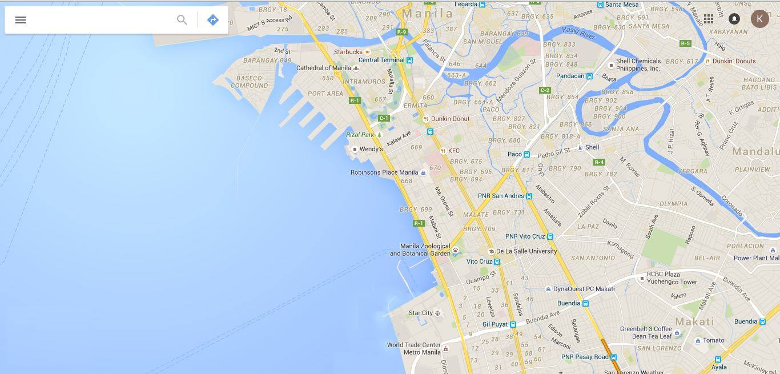


Aegis
Infographics
Contact Numbers
Login
Sign up

Slide 2

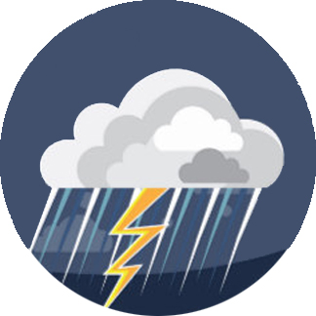
Aegis
Infographics
Contact Numbers
Login
Sign up

Slide 3

Aegis
Infographics
Contact Numbers
Login
Sign up

Slide 4
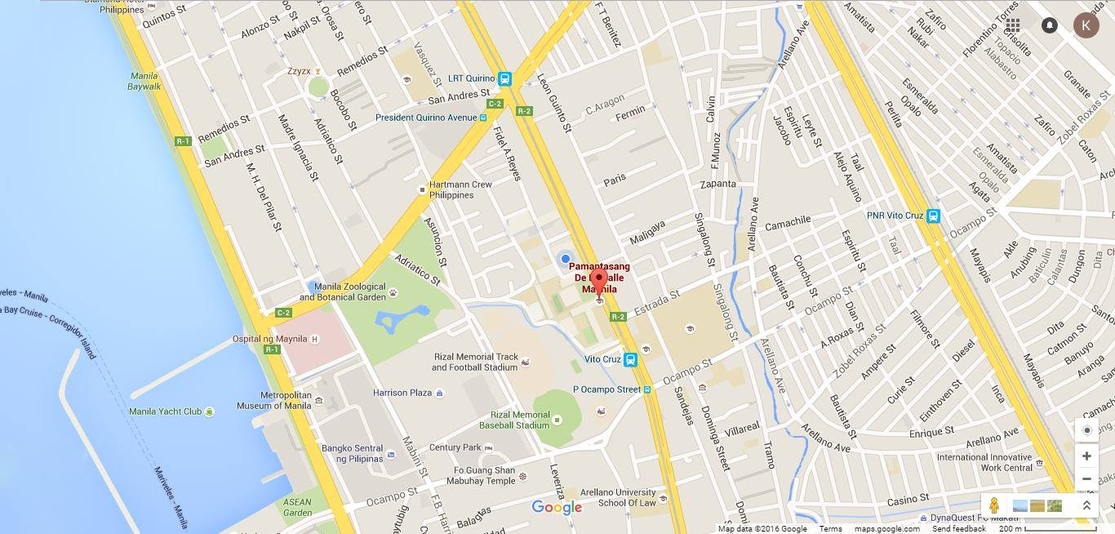

Aegis
Infographics
Contact Numbers
Login
Sign up

Slide 5

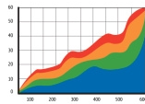
Aegis
Infographics
Contact Numbers
Login
Sign up
Analytics
Flood History:
Risk Score:
Your area has a
69%
of getting flooded

Slide 6
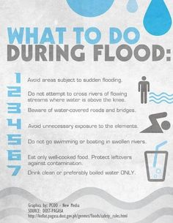
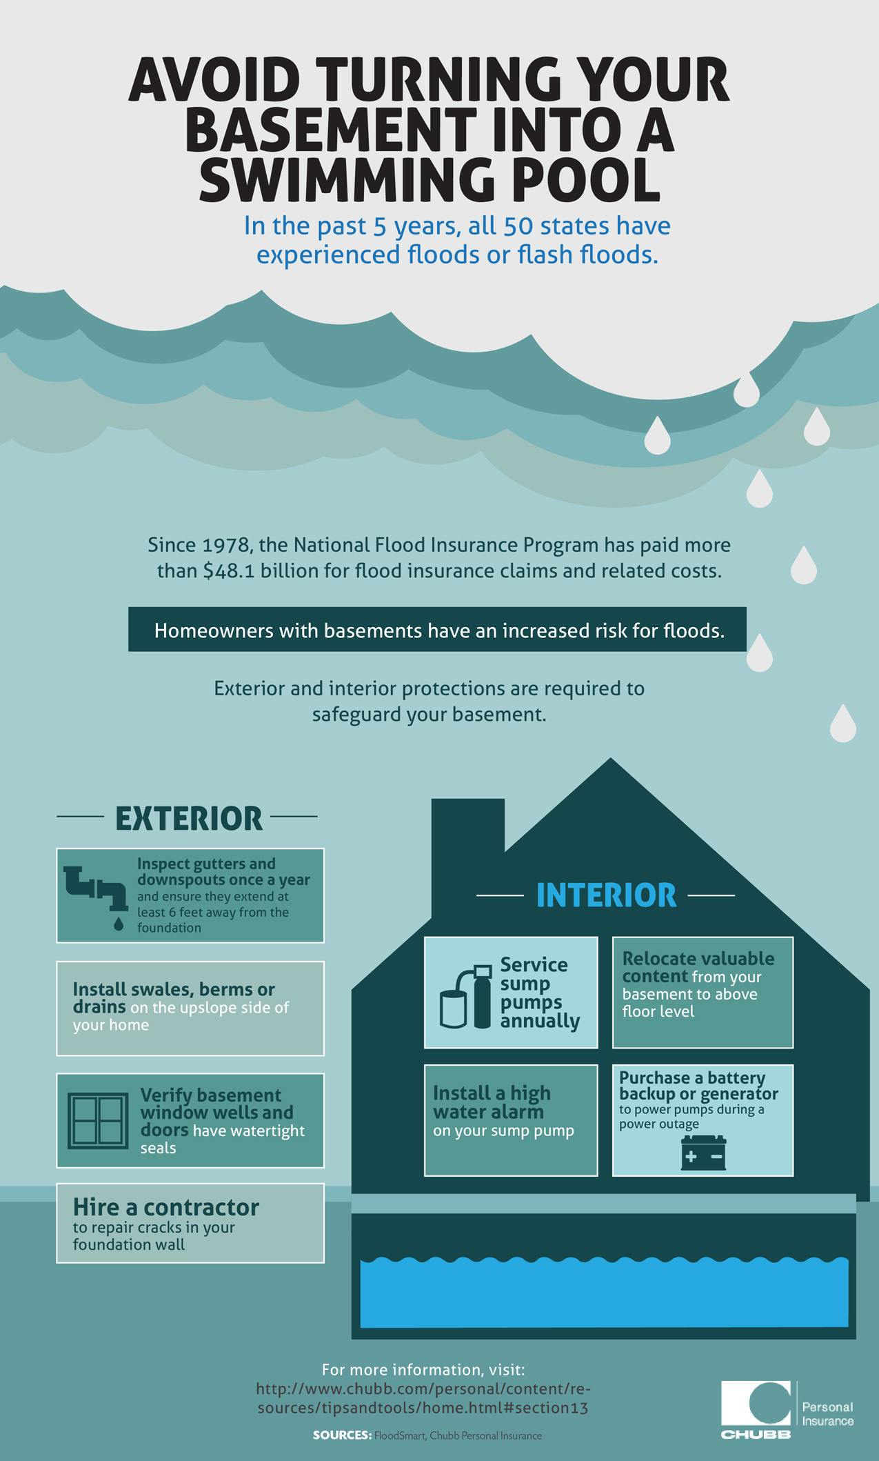
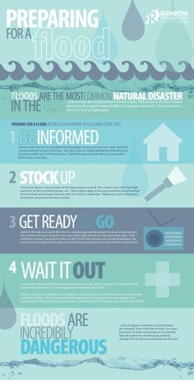
Aegis
Infographics
Contact Numbers
Login
Sign up
of getting flooded

Slide 7

Aegis
Infographics
Contact Numbers
Login
Sign up
Login
Username
Password
Create an account
Login

Slide 8
Aegis
Infographics
Contact Numbers
Login
Sign up
Sign Up
Username
Password
Create an account
Sign Up

Slide 9







Aegis
Infographics
Contact Numbers
Login
Sign up
NDRRMC
Pagasa
PHIVOLCS
For damage assessment and consolidated reports on government action
For damage assessment and consolidated reports on government action
For damage assessment and consolidated reports on government action
Hotlines:
(02) 911-1406
(02) 912-2665
(02) 912-5668
(02) 911-5061 to 64
Hotlines:
(02) 911-1406
(02) 912-2665
(02) 912-5668
(02) 911-5061 to 64
Hotlines:
(02) 911-1406
(02) 912-2665
(02) 912-5668
(02) 911-5061 to 64
Social Media:
Social Media:
Social Media:

